Slide 1
Capstone Project Tableau
Customer Churn Analysis
-Rohan Deshmukh
DA92S9-EN12024077730

Slide 2
Business Objective
A certain bank in North America wants to perform customer churn analysis, as the credit card business of the bank is not performing very well. Churn analysis will help the bank evaluate the customers who have stopped purchasing the credit card of the bank and figure out measures to reduce the bank's customer loss rate
As data analyst, has been asked to analyze the banks customers' churn data by performing the tasks

Slide 3
Challenge definition
Python
Display the summary statistics of the dataset
Identify the outliers in the dataset. (if there any)
Identify the missing values in the dataset and display the count of missing values.
Tableau
Task 1: Display the percentage of the attrited and the existing customers from the data.
Task 2 Display gender-wise percentage of the attrited and the existing customers.
Task 3: Display region-wise percentage of the attrited and the existing customers.
Task 4: Display the percentage of the attrited and the existing customers for each card category
Task 5: Display the percentage of the attrited and the existing customers for each income category.
Task 6: Display region-wise count of customers. Identify the region that has the maximum number of customers.
Task 7: Create an interactive dashboard by following the given instructions:
Create a Figma template for the dashboard
Design the dashboard with the charts created in tasks 1-6.
B Apply action filters on the charts created in tasks 1 and 6
Task 8: Identify 5 to 10 more points of analysis, present them using charts/graphs, and build an interactive dashboard using these charts/graphs Give proper interpretations by inferring data from the dashboard
Display Attrited based count on Education level
Display Customer age wise Client count
Display Region wise card category wise card category count
Display Income category wise Gender count
Display Education level wise Attrited Count treemap
Display Income category wise credit limit
Create an interactive dashboard

Slide 4
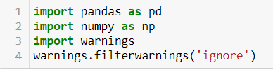
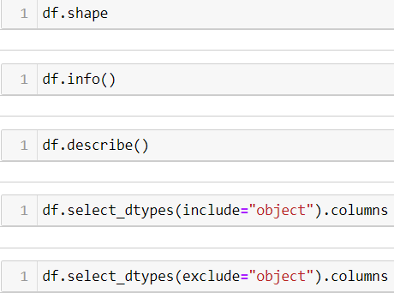


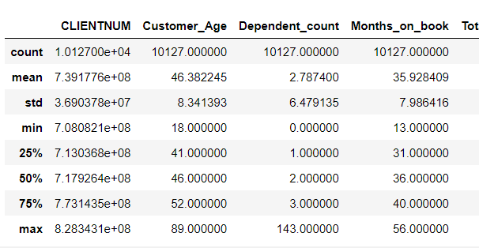
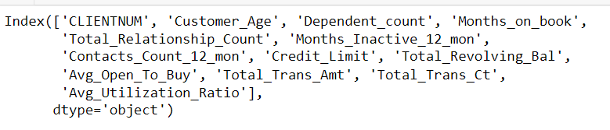

Python Tasks
Importing libraries
Loading value in dataframe
Summarizing data

Slide 5
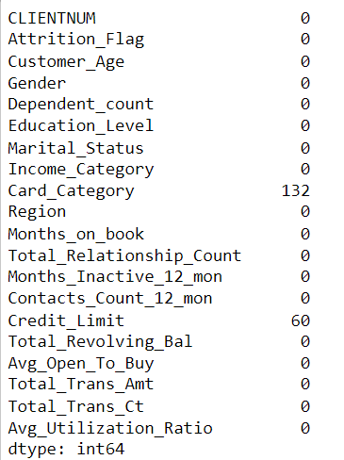
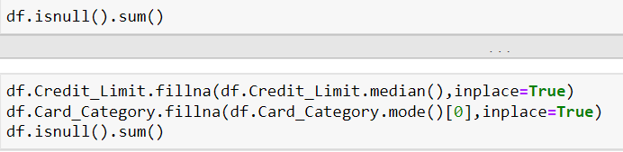
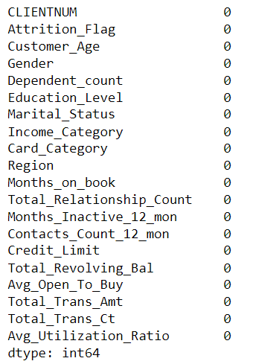
Python Tasks
In this we are finding null values and replacing or remove the values
We got 2 columns with null value so we replaced it with Median and Mode

Slide 6
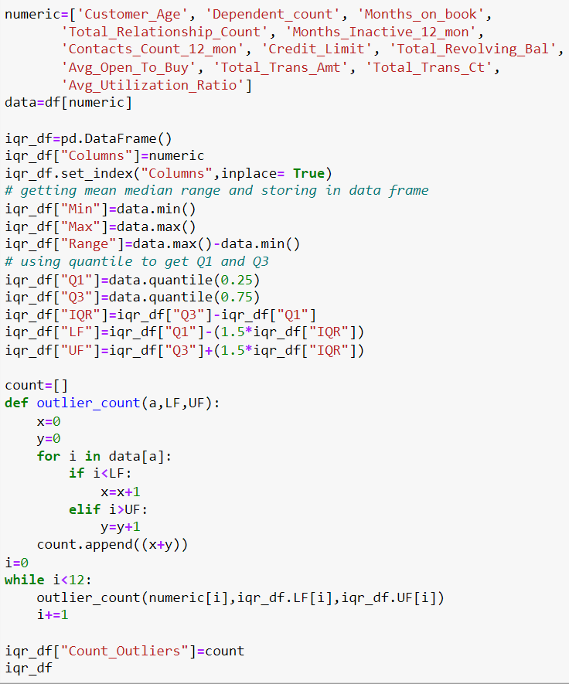
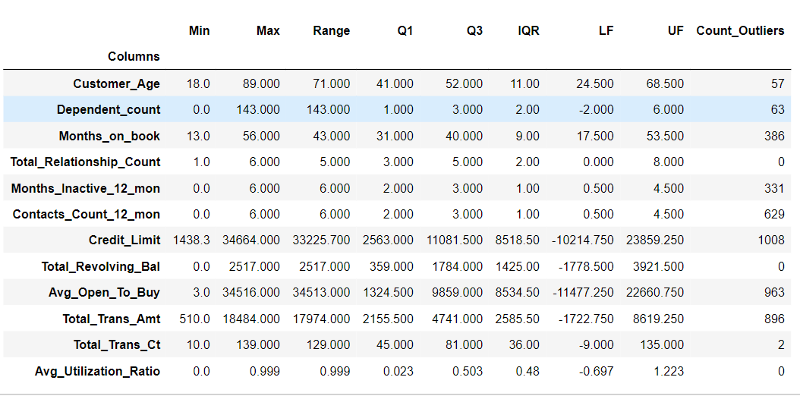
Python Tasks
We are doing outlier analysis on the numerical column
Yes we found a lot of outliers in numerical columns and we can say max outliers are in Credit_Limit

Slide 7
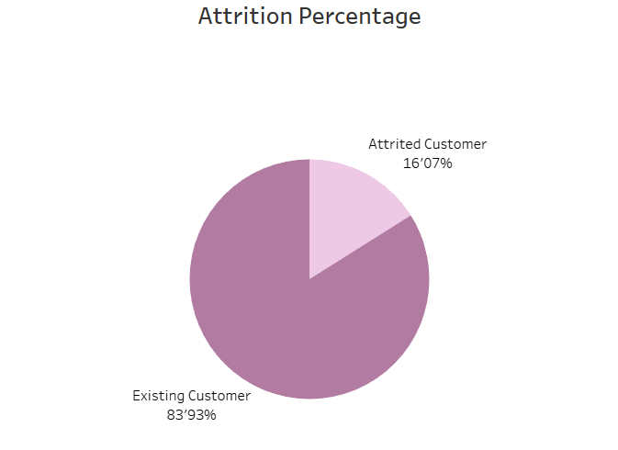
Tableau Finding Churn: Task 1
I drew a pie chart to get attrition percentage based on client count
We can see that over 16’07% of clients are churn in the given data

Slide 8
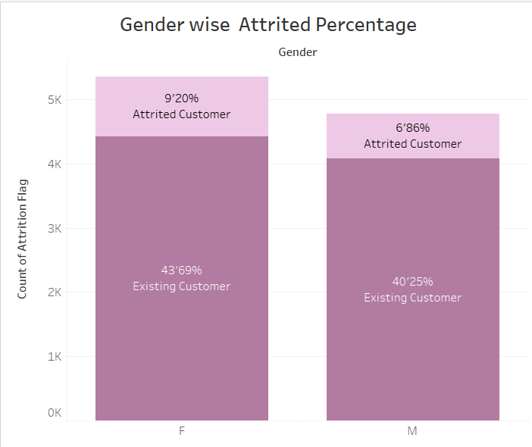
Tableau Finding Churn: Task 2
I created a bar chart to show the percentage of customers who churned, by gender.
Females are more likely to churn than males, even when other factors are not taken into account

Slide 9
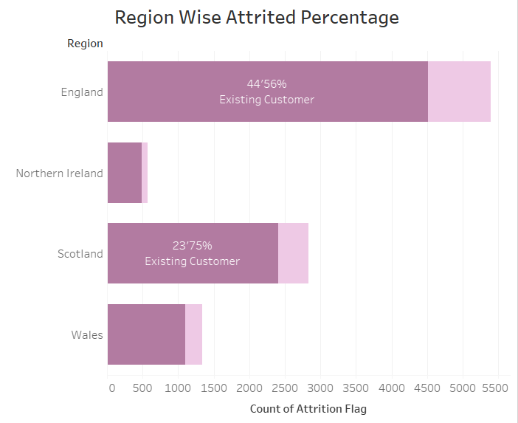
Tableau Finding Churn: Task 3
I used a bar chart to visualize the percentage of churn between regions, with region as the dimension and count of churn as the value
England has the highest churn rate of all regions

Slide 10
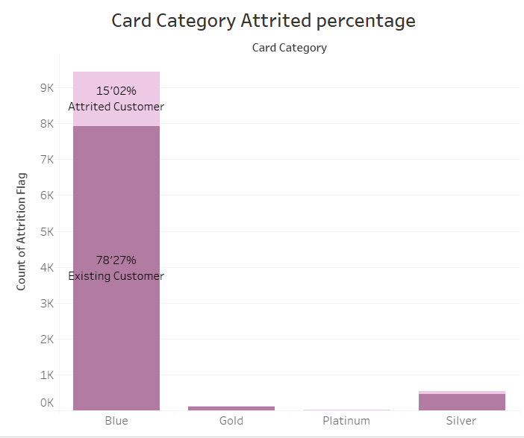
Tableau Finding Churn: Task 4
I created a bar chart to visualize the percentage of churn by card category.
Among card categories, Blue card users are most likely to churn.

Slide 11
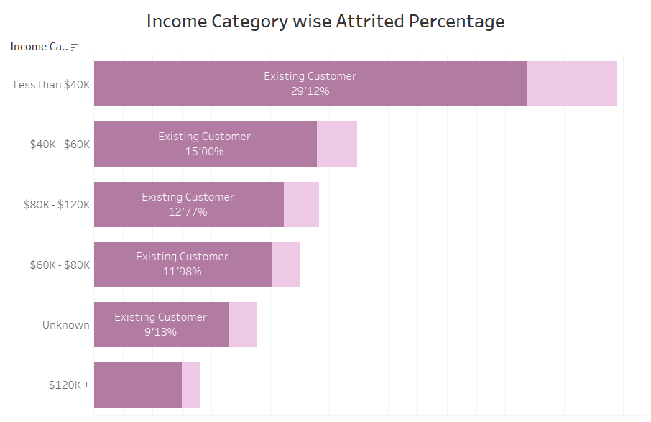
Tableau Finding Churn: Task 5
I used a bar chart to visualize the percentage of churn by income category.
There is a negative correlation between income and churn.

Slide 12
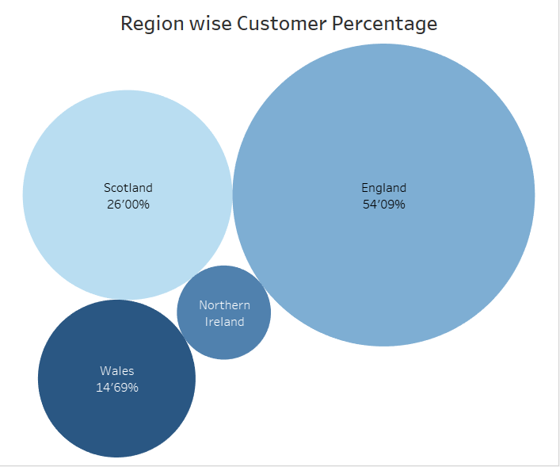
Tableau Finding Churn: Task 6
I used a bubble chart to visualize the count of people living in different regions, with the region as the dimension and the count of client number as the value
The chart shows that people living in England are more likely to churn

Slide 13
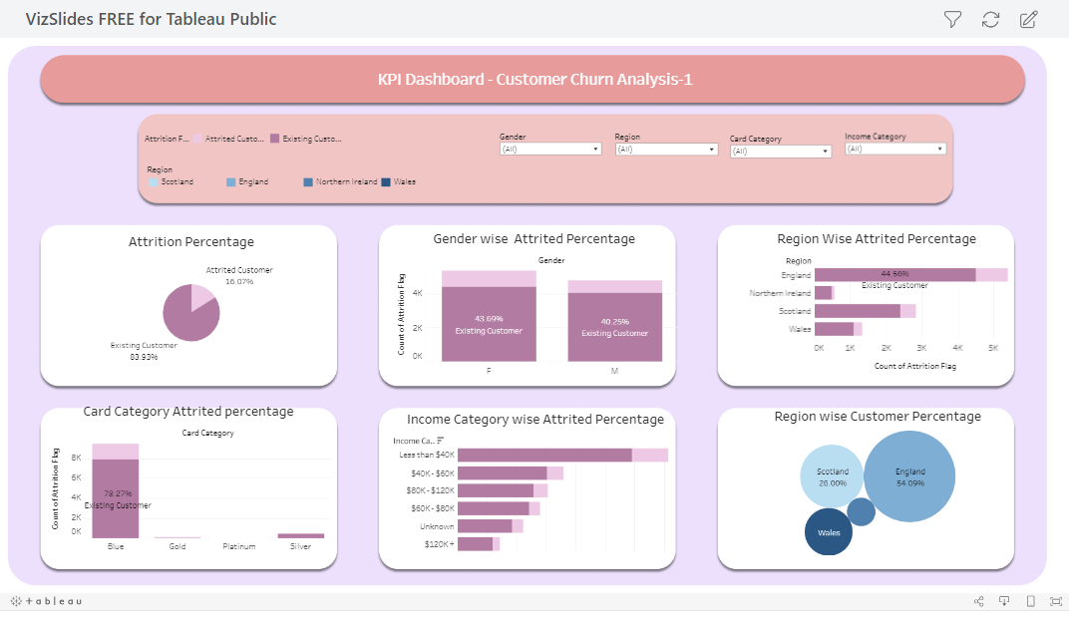
Tableau Finding Churn: Task 7
Dashboard 1
Dashboard Link

Slide 14
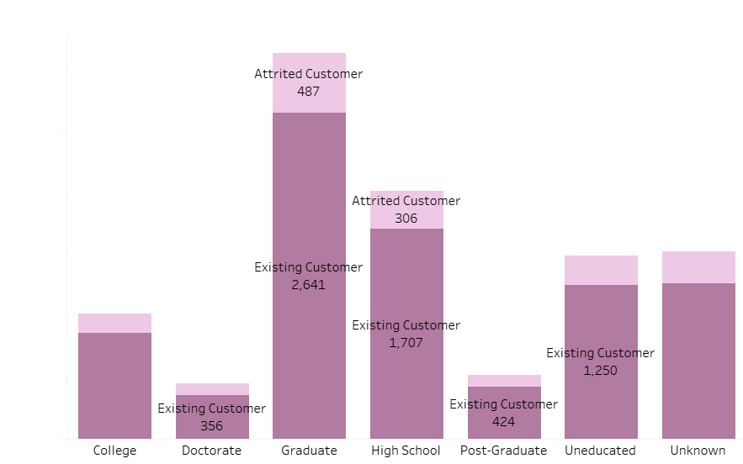
Tableau Finding Churn: Task 8
I used a bar chart to find attrited count based on Education Level
The chart shows that Graduate are more likely to churn

Slide 15
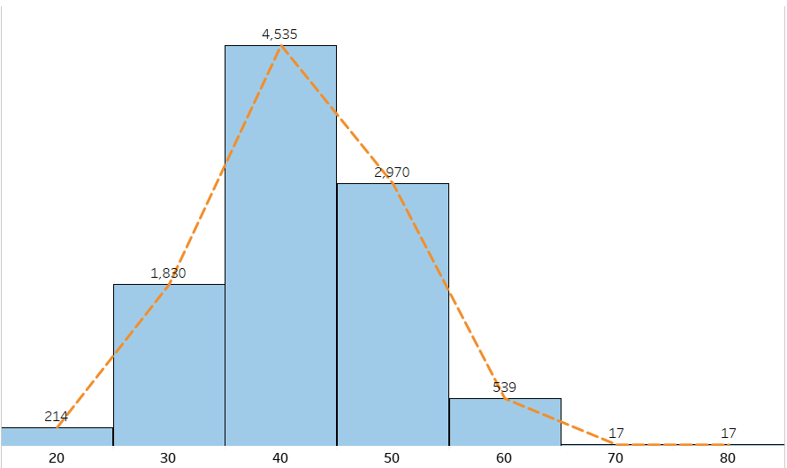
Tableau Finding Churn: Task 9
I used a histogram for age group and client count to find churn rate
The chart shows that 35 to 45 age group are more likely to churn

Slide 16
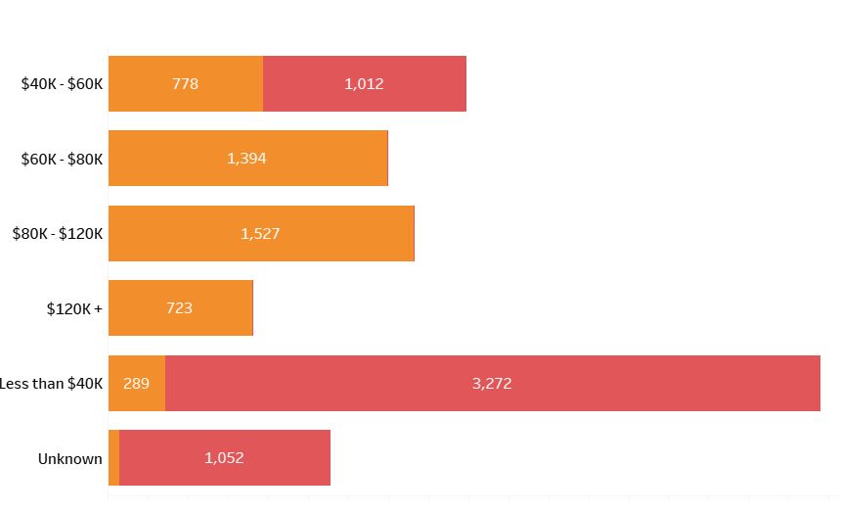
Tableau Finding Churn: Task 10
I used a bar graph for income category based on gender
The chart shows that more female for less than $40k and men for $80k-$120k

Slide 17
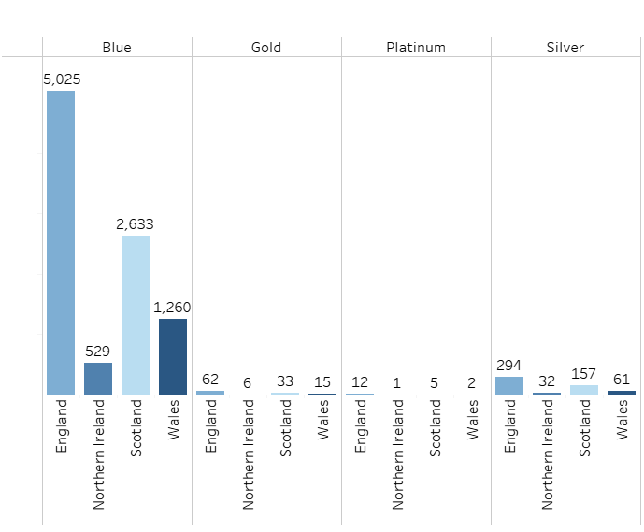
Tableau Finding Churn: Task 11
I used a bar graph for card category count based on region
The chart shows that more Blue card in England then rest

Slide 18
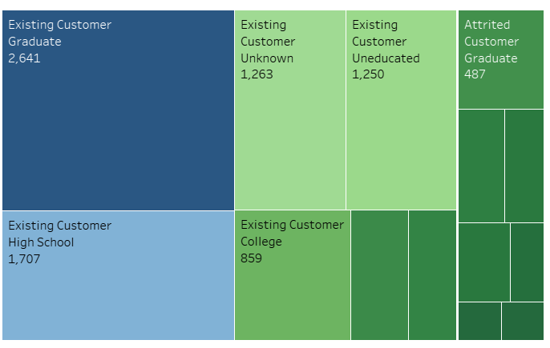
Tableau Finding Churn: Task 12
I used Education level wise Attrited Count treemap
The chart shows that more Existing customer in Graduate section

Slide 19
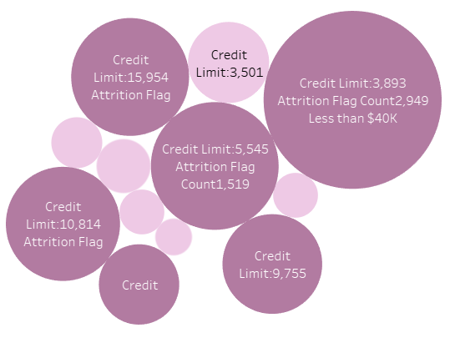
Tableau Finding Churn: Task 13
I used bubble Income category wise credit limit
The chart shows that more attrited value in less than 40k

Slide 20
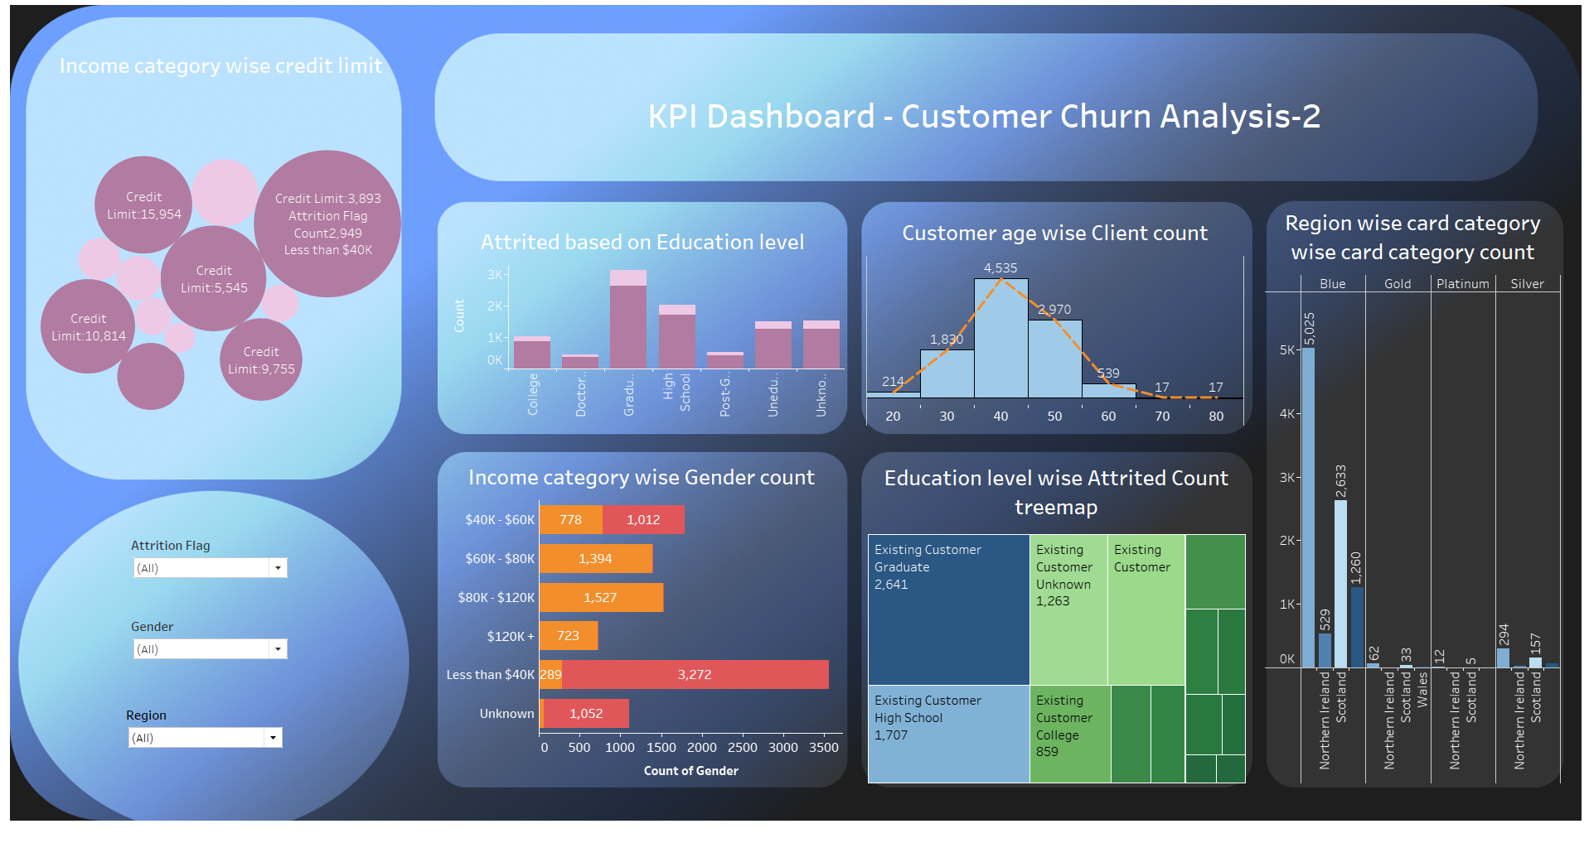
Tableau Finding Churn: Task 14
Dashboard 2
Dashboard Link

Slide 21
Conclusion
We used data visualization and an interactive dashboard to analyze customer churn data. This helped us find ways to reduce customer attrition in the bank's credit card business.
Based on these findings, the company could focus their retention efforts on the following groups:
Females
People in England
Graduates
People in the 35-45 age group
People with lower incomes
Blue card users
Existing customers
People in the less than $40k income group

Slide 22
Thank You
-Rohan Deshmukh
DA92S9-EN12024077730

